Slide 1
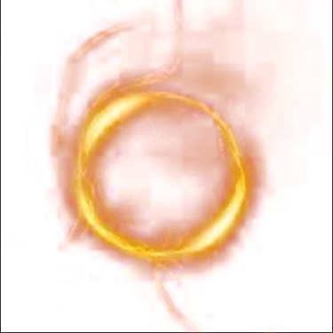
Systemic Social Mechanism To determine common grounds
“If there was 1 thing you could do for peace, would you do it?”
"Help Bring Peace 1 Chat at a time”
By Mudib Rawoot (President of world peace catalyst fund)

Slide 2


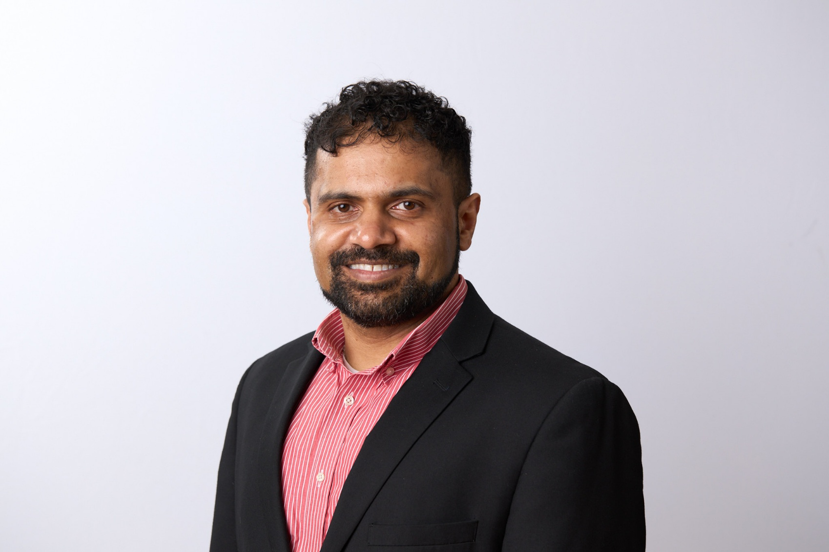



Mudib Rawoot
B.S. Chemical Engineering – Virginia Tech – 2010
M.S. Materials Engineering – University of Florida – 2012

Slide 3

Problem
U.N. Sustainability goal 16: Promote Peaceful and inclusive societies for sustainable development
Is there a way to world peace that ensures stability and prosperity for all?

Slide 4
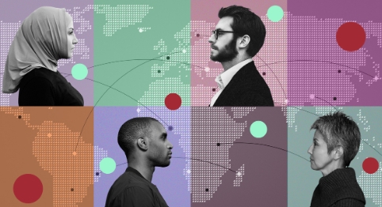
Solution – Cross-Cultural Conversations
If we know what bonds us and what separates us, the closer we will be to peace because we have common ground
The only way to learn this knowledge is by conversing with each other

Slide 5
Solution
WPCF has put together a systemic social mechanism to determine common grounds
Learning about each other will catalyze the way towards peace

Slide 6
Solution
Icebreakers (Android mobile application)
  Reduces communication barrier by 90%
  Employs heart effect for effective heart based conversations
  Allows for safe, easy, effective, connect the dots style, cross-cultural conversations

Slide 7
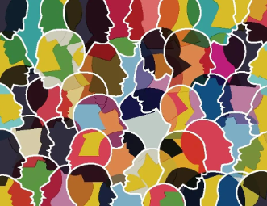
Mission Statement
WPCF aims to catalyze World Peace by facilitating cross-cultural conversations

Slide 8
World Peace Catalyst Fund
Only World Peace Non-Profit with an activity for you to help bring peace
Can perform this act several times a day
Can only help bring us closer to Peace

Slide 9

What is Icebreakers?
Ai, Spiritually Alchemical, Semiotic Social Media App (Android)
Down Right now – Will be back up, once funded
Soon to be available to iOS and Web App

Slide 10
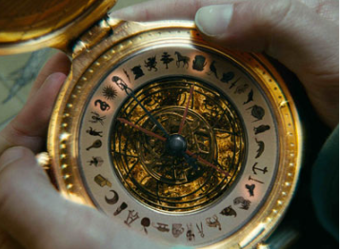
What is Icebreakers? - Inspiration
Alethiometer (Golden Compass) From his Dark Materials
Golden Compass:
  Compass with symbols
  Ask a question by picking 3 symbols
  Compass points to 3 other symbols as an Answer

Slide 11
Thought Experiment
If you pose a questions with symbols, and retrieve random images based on those symbols, can the retrieved images form a message that answers your question?
My Experimentation shows Yes!
Proof (Youtube Search for ‘GhostWriter Alpha Promotional Video’)

Slide 12
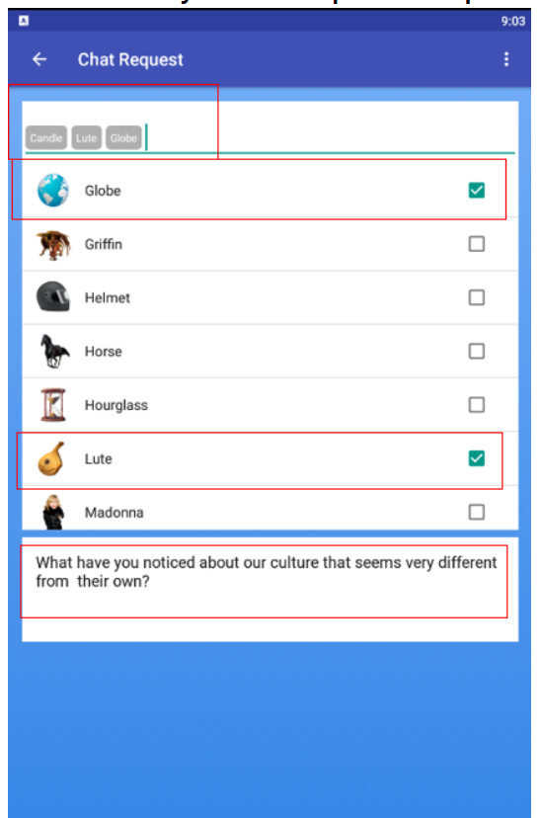
What is Icebreakers?
Users pose a questions to each other with symbols and text
Symbols are a universal language

Slide 13
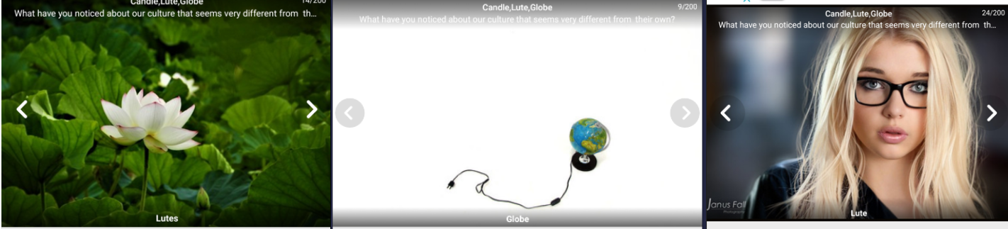
What is Icebreakers?
Application picks randomly drawn images based on those symbols
Each image is like a hieroglyph that answers question

Slide 14
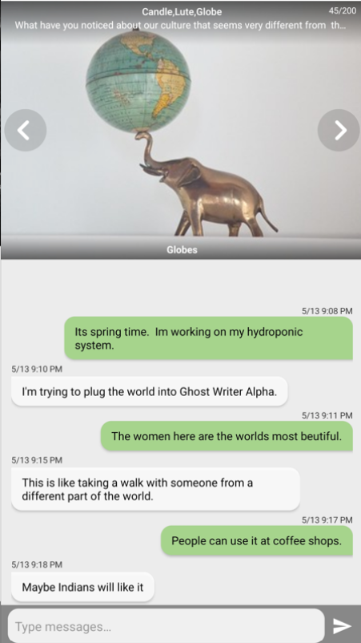
The Cross-Cultural Conversation
At least 3 texts from each users
They love each other – Social Bond
They hate each other – Social Bond
Neutral – Water under a bridge
All anonymous, all safe
Allows for free flow exchange of ideas and values

Slide 15
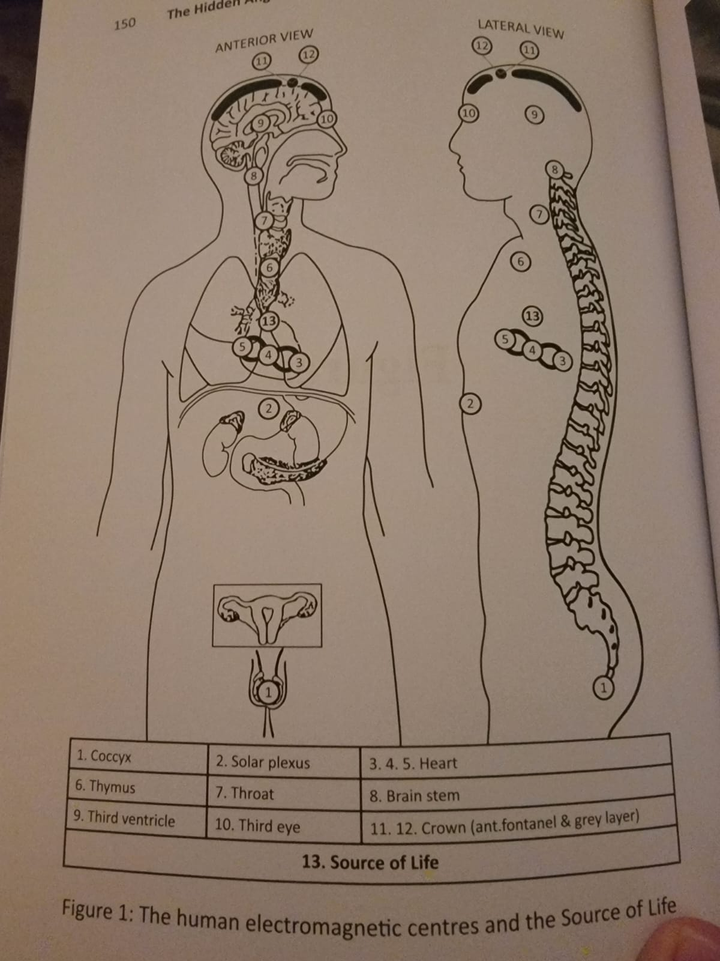
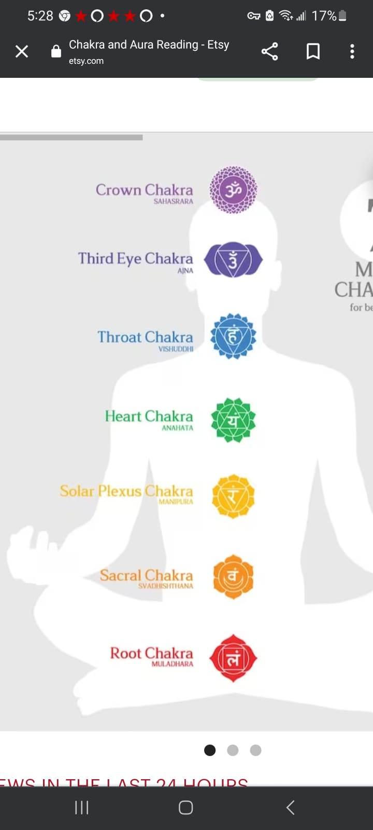
What makes Icebreakers Special?
Science says the randomly drawn images should never hold a message
Experimentation is showing that a message is enough to be significant– the Heart Effect

Slide 16
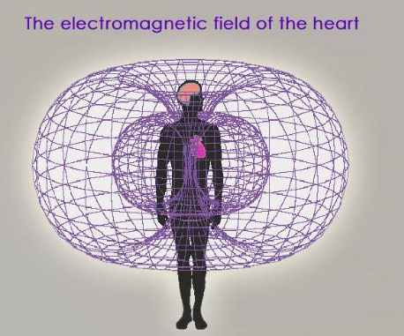
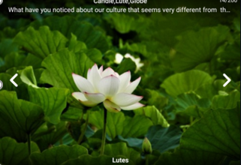
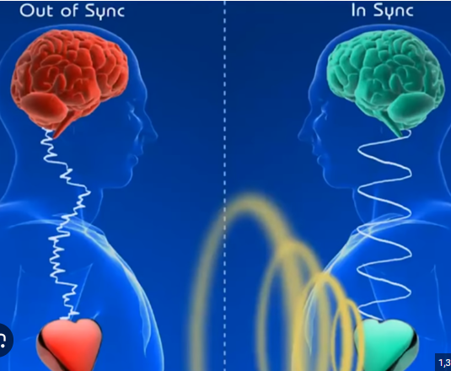
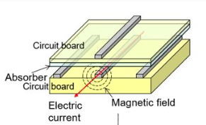
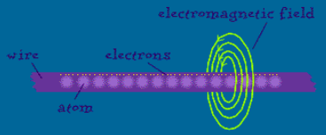
The Heart Effect
Electromagnetic field of heart goes through wires, connects with other person and picks up relevant images stored on servers

Slide 17
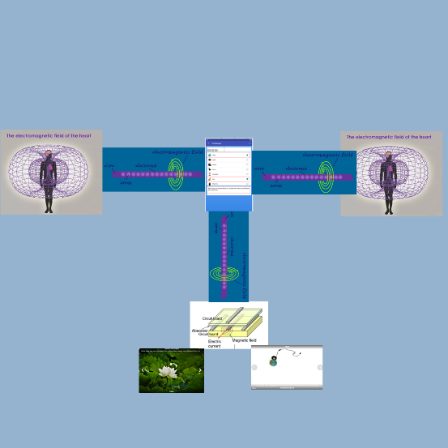
The heart effect
The resulting image feed comes from an bio-electro-magnetic heart based connection of each user

Slide 18
THE HEART EFFECT
Not every image is a hieroglyph
It may be the 1st, 5th, 10th image, however the message will standout
The message doesn’t form 100% of the time, it is like a skill level of the heart
Can practice and be turned into a game

Slide 19
Pieces to a Social Puzzle
Over millions of these conversations, common themes of bonding/separation will emerge
We all have different levels of understanding
With this mechanism, we have a distribution of where we stand and what we can say to each other to move from one level to the next

Slide 20
Pieces to a Social Puzzle
Ex: Israel/Palestine:
  50k people may hate each other and think 2-3 things
  20k people are ok with each other and think these 3-4 things
  Once we know what these things are, it is like pieces of a puzzle, we can move 50k people from a place of hate to a place of being ok with each other

Slide 21
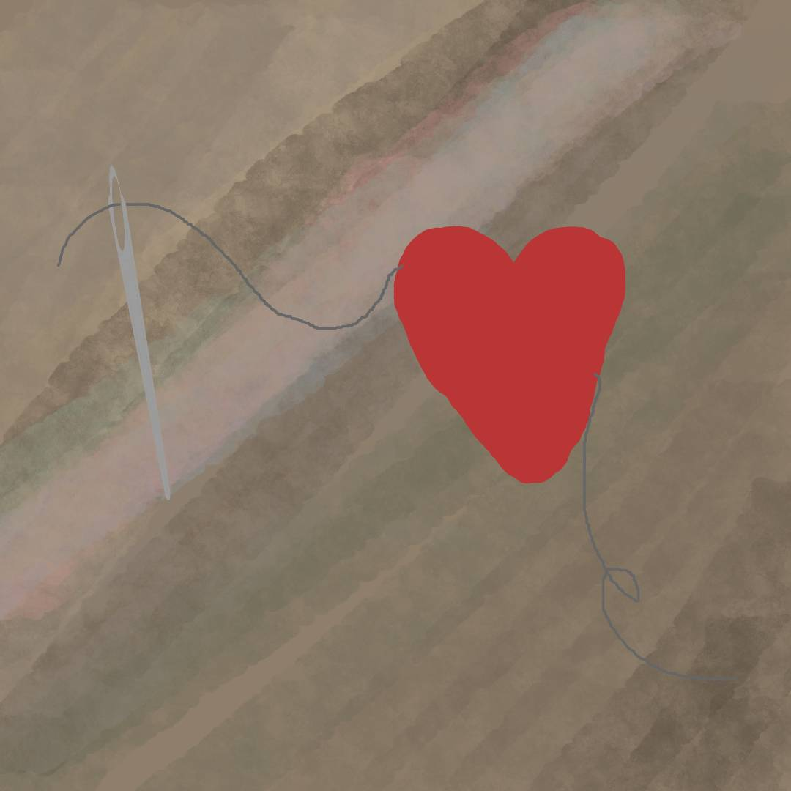
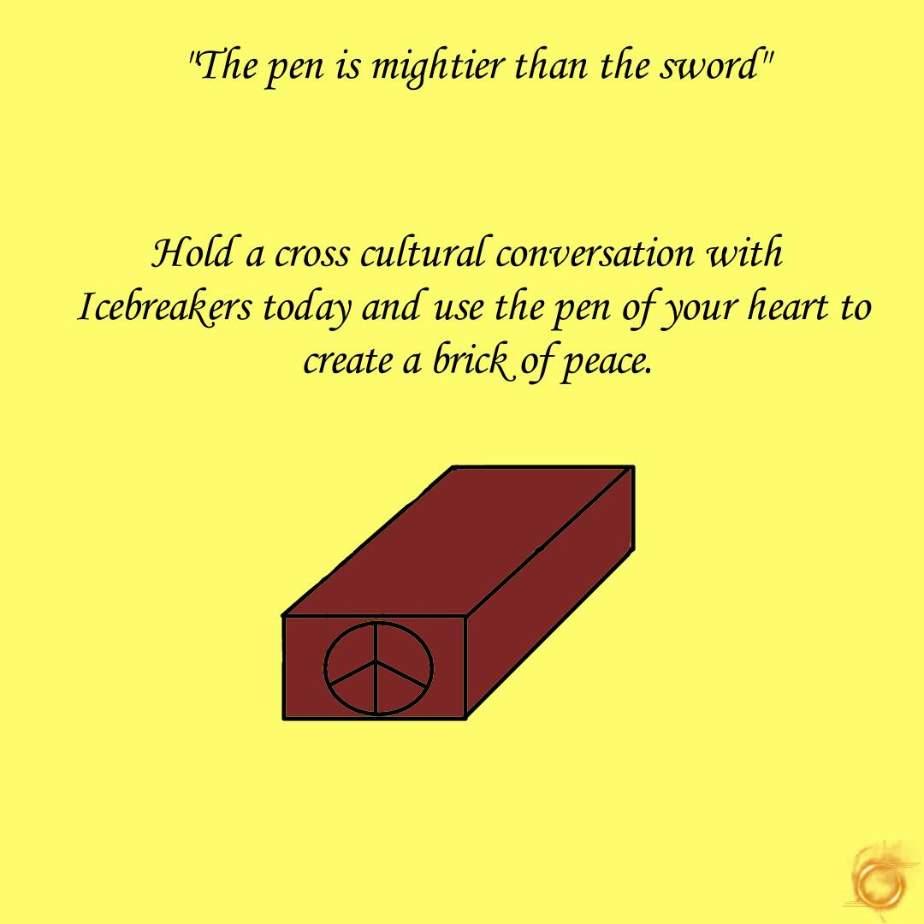
What makes Icebreakers Special?
Each of these conversations holds strong potential to reveal a bond of society = heart thread = brick of peace

Slide 22
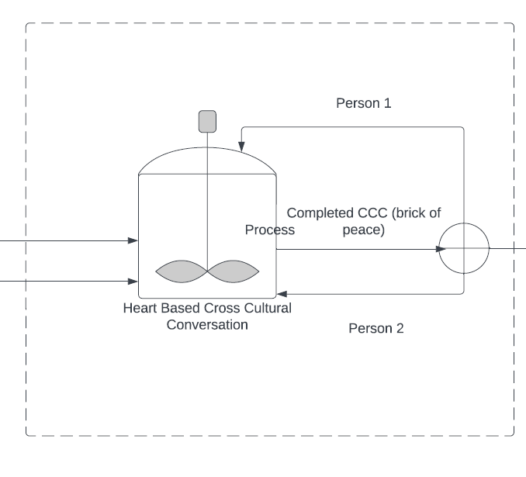
The Systemic Social Mechanism
Millions of heart based conversations each day geared around what separates us and what bonds us
Rinse, wash, repeat

Slide 23
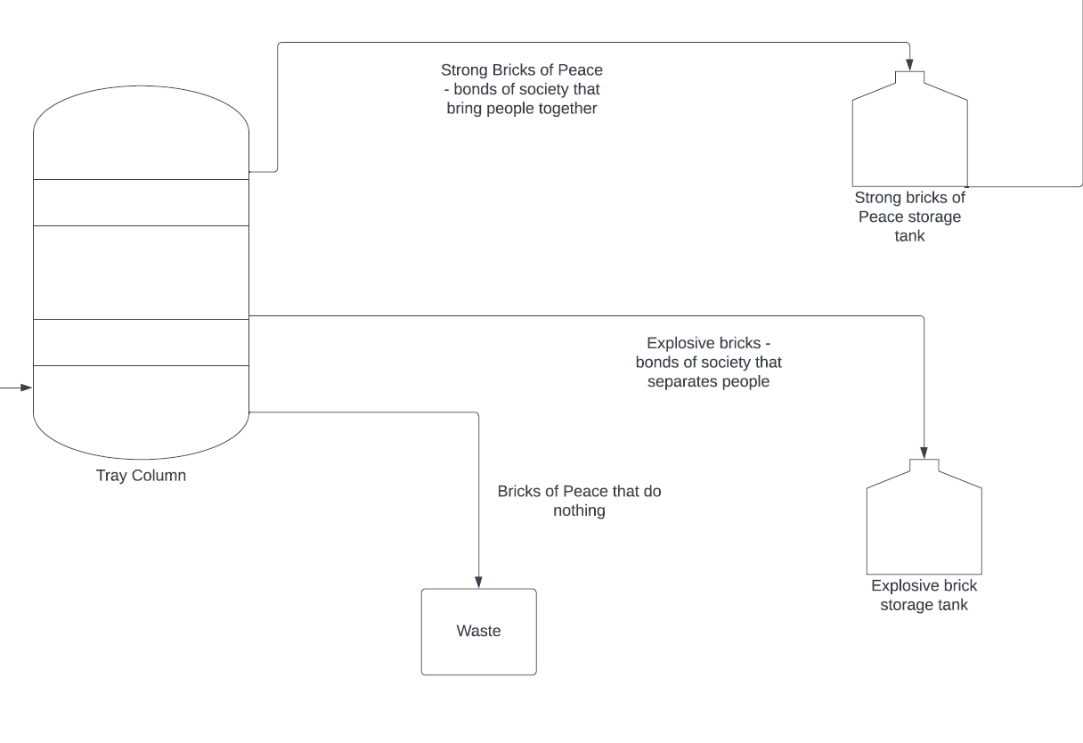
The Systemic Social Mechanism
All conversations get sent in for central analysis
WPCF can separate the conversations into categories

Slide 24
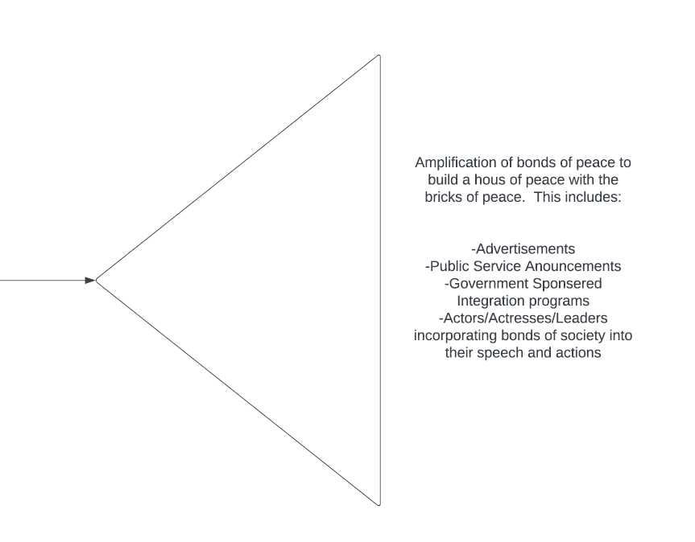
The Systemic Social Mechanism
Bonds get amplified by various methods and organizations
Allows for a reversible way to gear the public towards peaceful cohesion

Slide 25
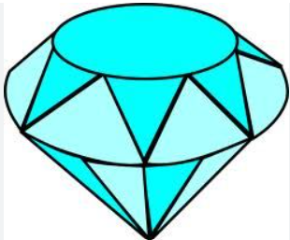
Measurable Way Towards Peace
Measure # of cross-cultural conversations
Measure # of common themes of bonding (Jewels)
Measure # of common themes of Separation
Surveys before and after amplification of themes of bonding

Slide 26



The Cross-Cultural Conversation
In addition – Each conversation is short and to the point and a stepping stone into the other social media apps
Users trade other social media profiles if they like each other

Slide 27
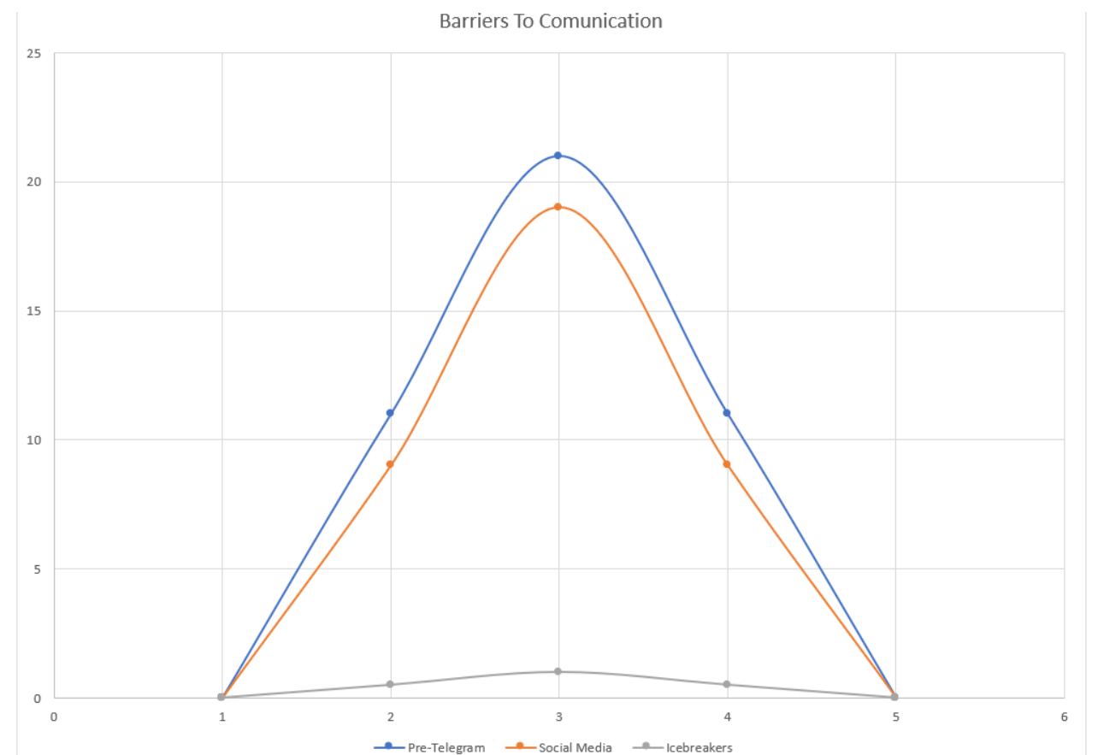
What makes Icebreakers unique?
Users are anonymous and start off as strangers
This reduces communication barrier by 90%

Slide 28
Abstract case Study
All government structures have a natural agreement between the peoples and the governing body
For any war to develop, a degree of separation must exist between the warring nations
If this degree of separation is not met, it is hard for a war/conflict to develop
Bonds of society decrease this degree of separation

Slide 29
Abstract CASE Study
As alternative solutions to war
  Soldiers can neglect their orders
  The peoples can form relationships and families with the soldiers
  New trade winds can develop – Natural Phenomena occurring throughout history

Slide 30
Examples
Russia/Ukraine – Peoples are not bonded enough so war is easy
Israel/Palestine – Peoples are not bonded enough so war is easy
US/Britain – Peoples are bonded so war is not easy

Slide 31

In Contrast (Israel/Palestine)
Israel/Palestine have been socializing directly for ~75 years.
How many bonds of society are there?
  I only count a few (Shawarma’s, Olives, Hummus, Babba Ganush)
  These were not widely known until about now

Slide 32
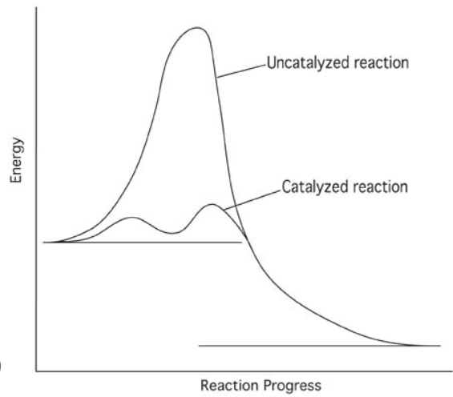
In Contrast (Israel/Palestine)
In contrast, these would have taken a few days to determine the bonds of society with Icebreakers
75 years to a few days…

Slide 33

In Contrast (Israel/Palestine)
Focus groups bring Israeli’s/Palestinians together to determine shared values
  Costly, dangerous, can be violent and very limited in scope (only a handful of participants thrown into a room together)
  Its like making Cat-Dog (never will happen)

Slide 34

In Contrast
In contrast, millions of people can use Icebreakers multiple times a day
Hundreds to thousands of shared values (bonds of society) determined and amplified with Icebreakers every day

Slide 35
You were Not Born Yesterday
Who is just going to believe ‘We have a systemic social mechanism that seems to all but guarantee peace’?
Therefore WPCF provides writing on the logic, reasoning, experimentation, and potential scenarios for your review
The sell is slow because WPCF bases it off logic/reasoning as opposed to emotion, however we are concrete and timeless

Slide 36
Writing
Logical Diagram
Treatises of World Peace
Systemic Social Mechanism Diagram
Instructions to experiment heart effect for your self
Available here

Slide 37
Competitive Analysis
We are Unique – There is no other semiotic social media application on the market
1400 world peace non-profits & none have action items towards peace or a way to discover bonds of society
We fit a niche in the World Peace Non-Profit Ecosystem
We fit a niche in the Social Media Eco-System
No competitors – Just symbiotic relationships

Slide 38
Competitive Analysis - World Peace Games
7+ games
  Connect the Dots Cross-Cultural Game - Push For Peace
  Find Your Love
  Find your BFF
  Terrorist Hunter Killer
  Hide & Seek
  Hone Your Heart
  ++

Slide 39
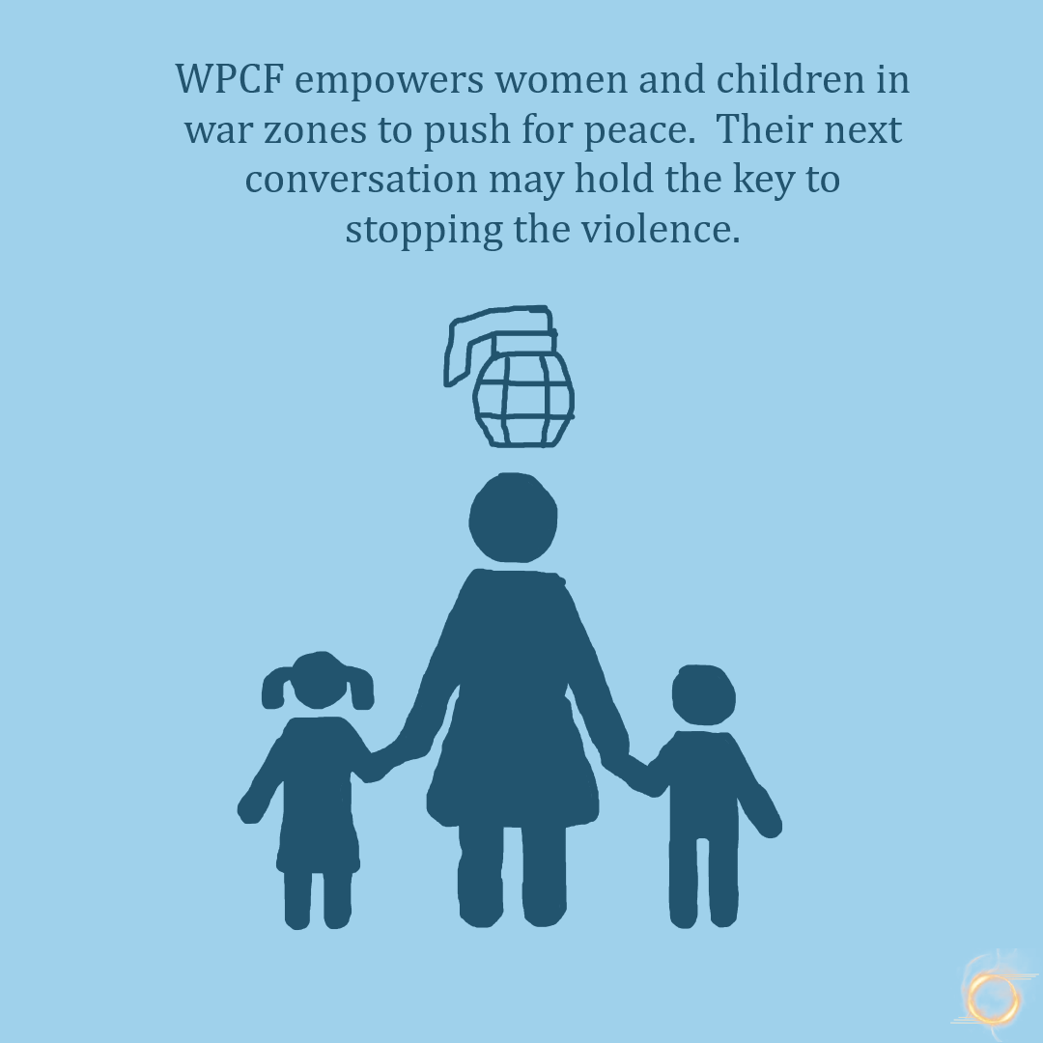
Competitive Analysis
Who else can say they can all but guarantee peace?
No One Except WPCF

Slide 40
10 other activities that can only bring peace
Read our writing (3) for education
Speak about our writing to grow the awareness
Post fight oppression memes on social media to create peer pressure for peace
Engage on social media (Instagram, Facebook Page, Facebook Group, ++)
Perform the Heart Effect Experiment
Volunteer

Slide 41
What in it for you?
A way for you to see your progeny enjoys a peaceful future
A way for you to connect with other cultures (your love may be on the other side of the world)
A way for you to hone your heart and develop your sense of self
A way for you to connect to your spiritual side
Jobs at all levels – stabilize economy
A way for you to make passive income (inquire for details)

Slide 42
The Ask - Guidance
You should by now know the benefits of donating – karma, ajr, good vibes
Per Islam – Zakat says donate 2.5% of yearly salary
Per Christianity – tit says donate 10% of yearly salary
WPCF is asking for 0.5%
If you are making millions, $5k should be max donation for you, otherwise I will have to collect privy details per tax regulations

Slide 43
The ask
Do you have advice? Is there anything you can do to help?
I want enough money to transition to running WPCF full-time.
$20 million – estimated ask once and never again
  12 million - budgeted
$500k – Good for 6 months
At some point there will be a need to convert into a PBC – Do you want to invest?
Donate

Slide 44
Ask Breakdown – $500k
Salaries
  President, 1x developers, 1x tester, 1x artist, 1x analysts, 1x Advertiser, 1x social media rep
IT infrastructure
Insurance
Electronic Equipment
Detailed Justification available upon request

Slide 45
Feedback
Please provide feedback, comments, anything that will help. WPCF appreciates the support
Contact: Mudib Rawoot
Email: outreach@worldpeacecatalystfund.org
https://www.worldpeacecatalystfund.org
Please take our Survey

Slide 46
To Donate
Donate page
Zelle to president@worldpeacecatalystfund.org
Write a check to ‘World Peace Catalyst Fund’ – email me for address to send to or I can pick up from you

